Slide 1
The Research and Implement of Real-Time Plasma Electron Density Calculations on EAST
10th IAEA Technical Meeting on Control, Data Acquisition, and Remote Participation for Fusion Research
Z.C Zhang, H.Q. Liu, B.J. Xiao, F. Wang, Q.P. Yuan, Y. Yang, Y. Wang
Institute of Plasma Physics, Chinese Academy of Sciences,
Hefei, Anhui 230031, China

Slide 2
OUTLINE
Introduction
System Realization
Measurements and Results
Conclusions
Acknowledgments
References

Slide 3
Background
Plasma activities associated with electron density profile in tokamak.
Plasma confinement and Magneto-Hydro-Dynamic(MHD) activity
Tokamak operation, including PCS real-time control
-- Received from reference [1][2][3]
Purposes
To calculate the electron density real-time
To transfer the processed data to PCS for control

Slide 4
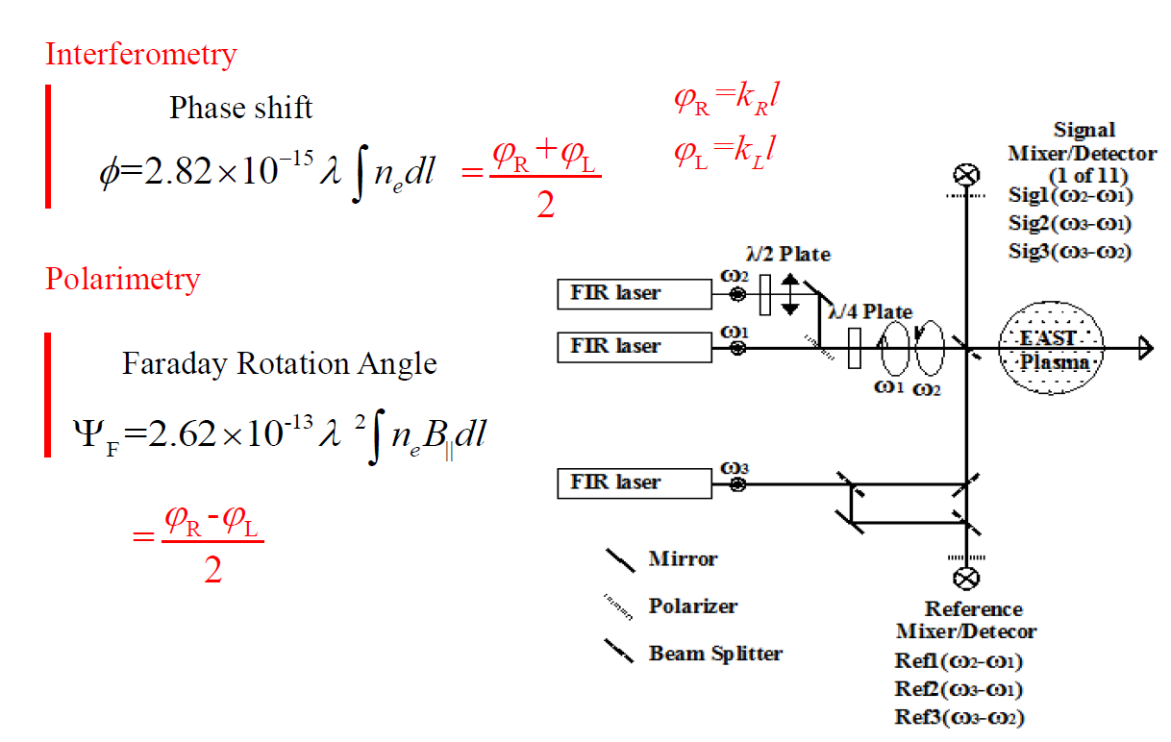
Introduction
3-wave far-infrared (FIR) POlarimeter-INTerferometer (POINT) system
HCOOH laser
line-integrated plasma density is proportional to phase shift
-- Received from reference [2][3]
Notes:
The lasers are used to Detect faraday rotation angle and electron density. The formic acid lasers operating at 432 micrometer.

Slide 5
Prototype design
POINT
System
PCS
System
Acquisition
Module
Digital
Filter
Phase
Comparator
Density
Arithmetic
RFM
Module
Density Calculations System
Module design for density calculations system

Slide 6
OUTLINE
Introduction
System Realization
Measurements and Results
Conclusions
Acknowledgments
References

Slide 7
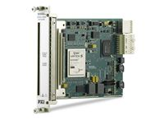
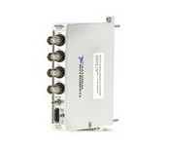
Hardware structure
CLK
TRIG
Raw Data
CHASSIS PXIe-1085
CONTROLLER
Flex RIO
RFM
PXIe-8135
LabVIEW RT
PXIe
7966R
PXIe
7966R
PXIe
7966R
PXI
5565
NI 5734
NI 5734
NI 5734
Phase Shift
MDSplus
Density
PCS
Hardware structure of density calculations system
Flex RIO Module
Digitizer Adapter Module
Virtex-5 SX95T FPGA
512 MB onboard DDR2 DRAM
Access to 132 single-ended I/O lines
16 DMA channels for high-speed data streaming at more than 800 MB/s
16 bit resolution
4 BNC connector
50 Ω impedance
NI PXIe-7966R
NI 5734

Slide 8
Software architecture
Digital Data
Phase Shift
RT vi In controller
TRIG
Adapter
Module
CLK
Flex RIO
FPGA
Watch Dog Module
REF
POINT1
Local
Storage
MDSplus
Database
Adapter
Module
CLK
Flex RIO
FPGA
MEMORY
POINT2
POINT3
Density
POINT4
Adapter
Module
Flex RIO
FPGA
Retroflexion
Module
Initiali-
zation
CLK
POINT5
TO PCS
RFM Device
Density
Software architecture of density calculations system
REF
Digital Data
Digital
Filter
FFT
Module
Arithmetic
Unit
iFFT
Module
Digital-Phase
Comparator
Phase Shift
POINT
Digital Data
Digital
Filter
FFT
Module
Arithmetic
Unit
iFFT
Module
0.85MHz, 1.275MHz,2.125MHz
Block diagram of Flex RIO FPGA

Slide 9
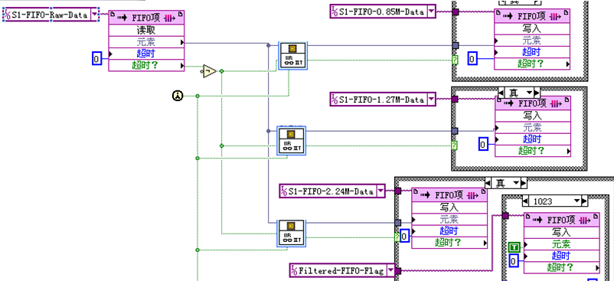
Program diagram and compile results
0.85M
1.275M
2.125M
Program diagram of Filter Module
Configuration of filter
Total Slice
Compile results of FPGA

Slide 10
Retroflexion module
Phase Shift
C
B
A
D
Zero-Offset
Y
Phase (DEG)
Φ[k]
Interference Data?
N
t/s
Phase shift @ Shot NO.50650
Retroflexion？
Count n
Φ[k]=Φ[k-1]
A
Normal data points
N
n
Y
n ± 1
Difference value between two adjacent data points should be less
Phase Shift
Φ =Φ ± n x 360
B
Interfered data points
Noise interference, should be replaced by former points average
N
C
Retroflexion data points (UP)
Discharge End?
Large difference value between two adjacent points, smaller than former
Y
Φ[k]=0
D
Retroflexion data points (DOWN)
Large difference value between two adjacent points, bigger than former
END
Software workflow of retroflexion module

Slide 11
OUTLINE
Introduction
System Realization
Measurements and Results
Conclusions
Acknowledgments
References

Slide 12
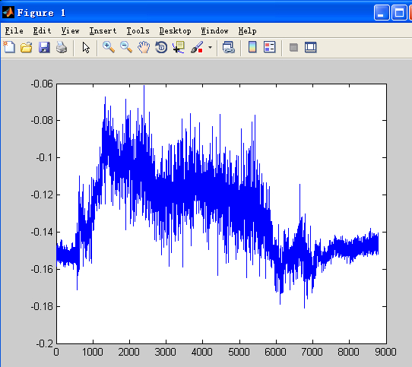
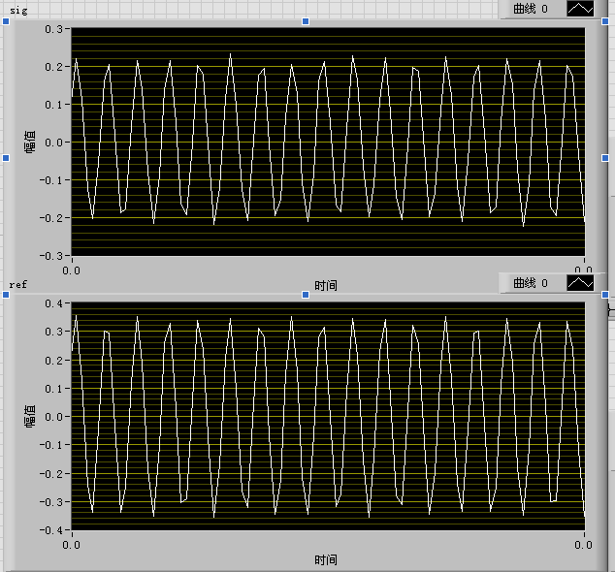
Bench test
Offline calculation results by Matlab
Raw data for bench test
Real-Time calculation results by new system

Slide 13
Experimental results
IP (KA)
Plasma Current @ Shot NO.50650
t/s
Phase (DEG)
Phase shift @ Shot NO.50650
t/s
DEN (e19/m³)
Electron density @ Shot NO.50650
t/s

Slide 14
OUTLINE
Introduction
System Realization
Measurements and Results
Conclusions
Acknowledgments
References

Slide 15
Conclusions
The density measurement system (DMS) has been developed to provide real-time data processing ability for EAST POINT system.
The DMS can access 5 channels data at the rate of 10 M Sample/s, easy-upgradable, extensible.
The bench test and experiment results in 2014’ EAST campaign meet the requirements of design.
Future work
11-channels RT DMS will be applied to the POINT.
Processed data will be uploaded to the MDSplus.
Density data streamed to the PCS will be test.

Slide 16
Acknowledgements
The author would like to thank the EAST CODAC Team and FIR Team for their work and help. This work is performed under the auspices of the Chinese National Fusion Project for ITER under grant No.2014 GB103000.

Slide 17
References
[1] XU Q, GAO X, JIE Y X, et al. HCN laser interferometer on the EAST superconducting tokamak [J]. Plasma Science and Technology, 2008, 10(4): 519-521.
[2]LIU H Q, JIE Y X, DING W X, et al. Faraday-effect polarimeter-interferometer system for current density measurement on EAST [J]. Review of Scientific Instruments, 2014, 85, 11D405:1-4.
[3] Zou Z. Y, LIU H Q, JIE Y X, DING W X, et al.Optical layout and mechanical structure of polarimeter-interferometer system for Experimental Advanced Superconducting Tokamak EAST [J]. Review of Scientific Instruments, 2014, 85, 11D409:1-3.

Slide 18
Thank you for your attentions !
धन्यवाद

